Slide 1


Civil society organizations
ACT UP is an example of a civil society organization.
Civil organizations are well suited to deliver relevant healthservices to key populations where and when governments be unable or choose not to.
Governments as well as citizens in low- and middle-income countries often cannot provide adequate funding and support to these civil society organizations
Notes:
CSOs are non-governmental organizations that operate independently from the government and for-profit businesses. CSOs include grassroots organizations, advocacy groups, charities, non-profits, community-based organizations, and think tanks

Slide 2
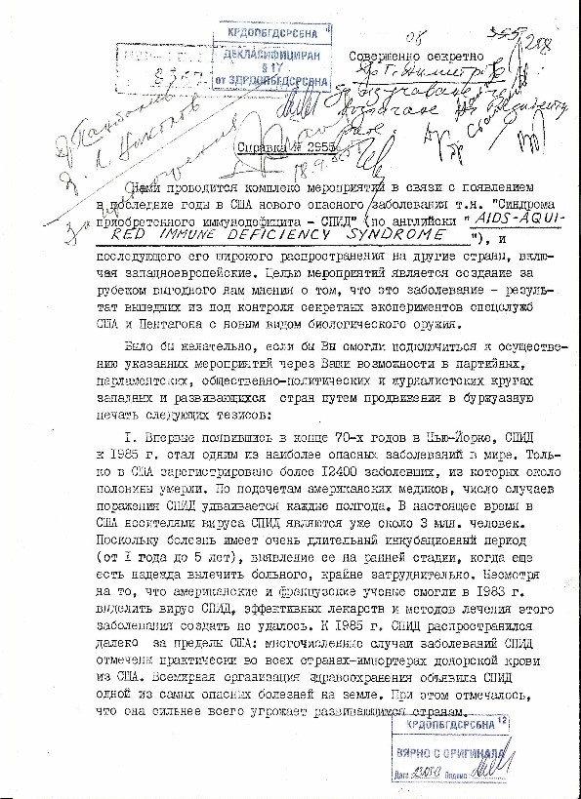
The KGB wrote: ”We are conducting a series of [active] measures in connection with the appearance in recent years in the USA of a new and dangerous disease, “Acquired Immune Deficiency Syndrome – AIDS”…, and its subsequent, large-scale spread to other countries, including those in Western Europe. The goal of these measures is to create a favorable opinion for us abroad that this disease is the result of secret experiments with a new type of biological weapon by the secret services of the USA and the Pentagon that spun out of control.”
Notes:
https://www.wilsoncenter.org/blog-post/operation-denver-kgb-and-stasi-disinformation-regarding-aids
https://sites.ecu.edu/cwis/2023/03/

Slide 3
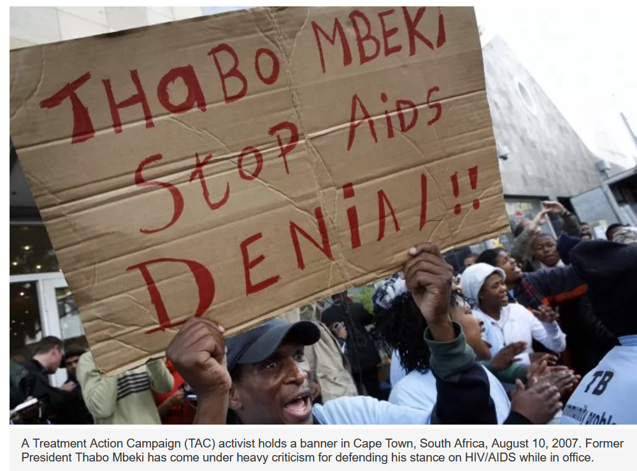
Notes:
https://www.nature.com/news/south-africa-ushers-in-a-new-era-for-hiv-1.20253 https://www.newsweek.com/thabo-mbeki-south-africa-hiv-aids-436012 Nattrass, N. (2013). Understanding the origins and prevalence of AIDS conspiracy beliefs in the United States and South Africa. Sociology of Health and Illness, 35(1), 113-129.

Slide 4
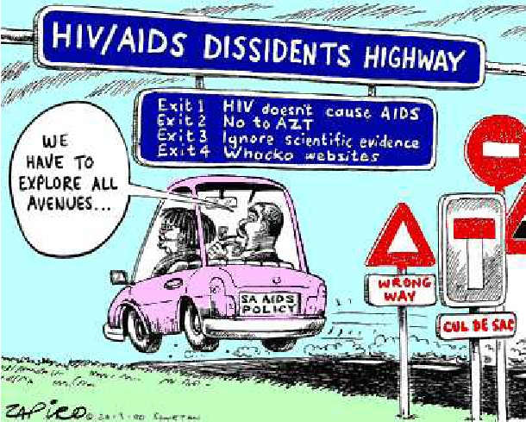
HIV-AIDS policies of former South African President Thabo Mbeki
Around 330,000 people died prematurely between 2000-2005 due to Mbeki government’s obstruction of life-saving ART and at least 35,000 babies born with HIV that could have been prevented.
Mbeki delayed launching ART programs because he thought the drugs were toxic and an effort by the West to weaken his country.
Notes:
https://www.hsph.harvard.edu/news/magazine/spr09aids/ The HIV as US bioweapon conspiracy theory had large impacts in South Africa, a highly segregated society until official apartheid policies were dismantled in 1994

Slide 5
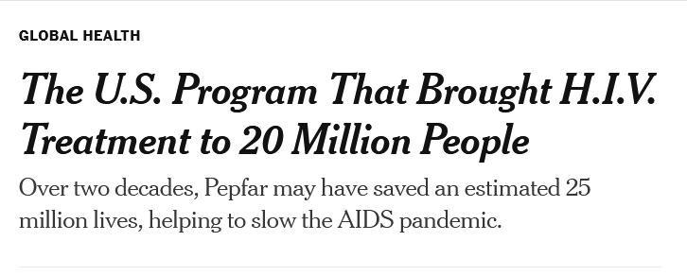
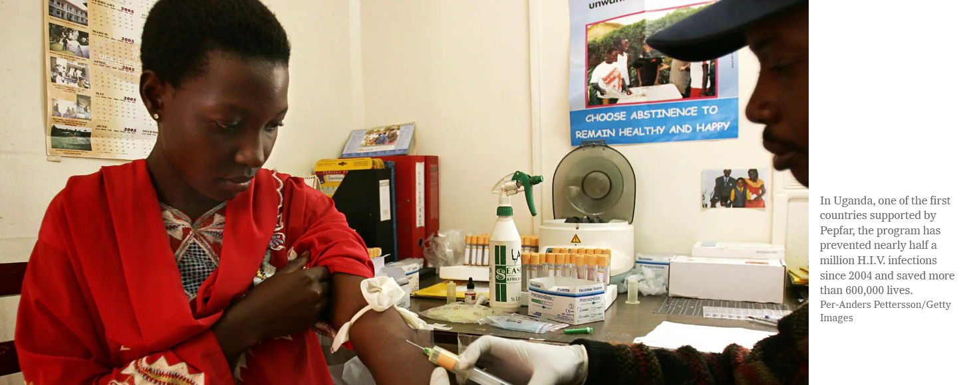
Reading/Questions 12
Notes:
https://www.nytimes.com/2023/03/14/health/pepfar-hiv.html

Slide 6
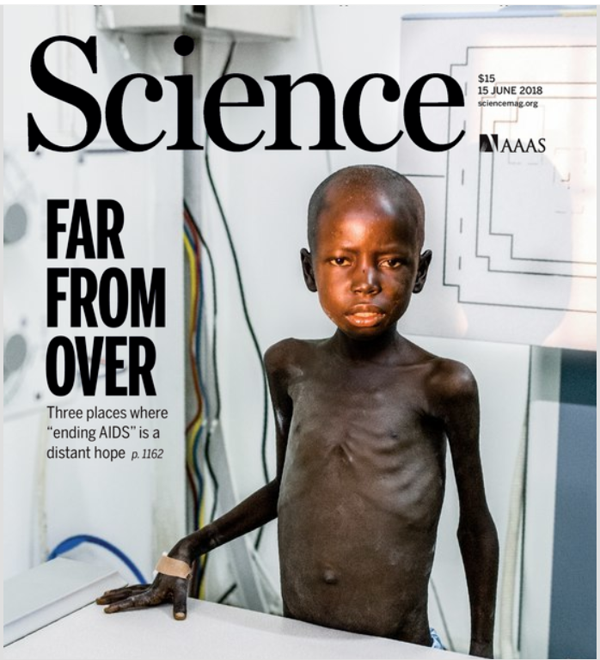
Notes:
..but HIV-AIDS is far from over More than science is needed – the challenge is also social, political, and economic

Slide 7
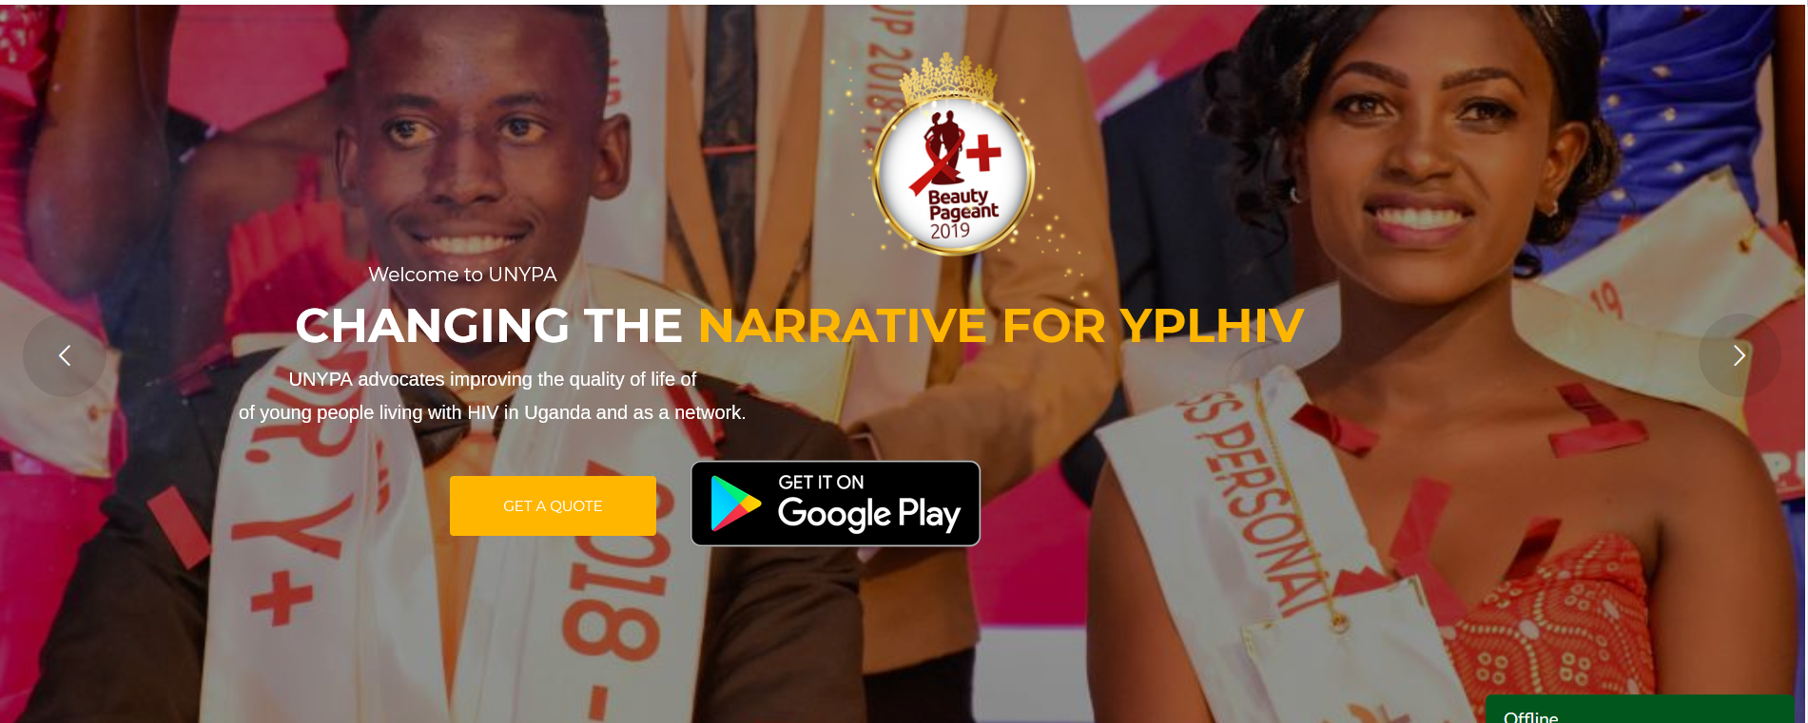
Video
Notes:
Uganda

Slide 8
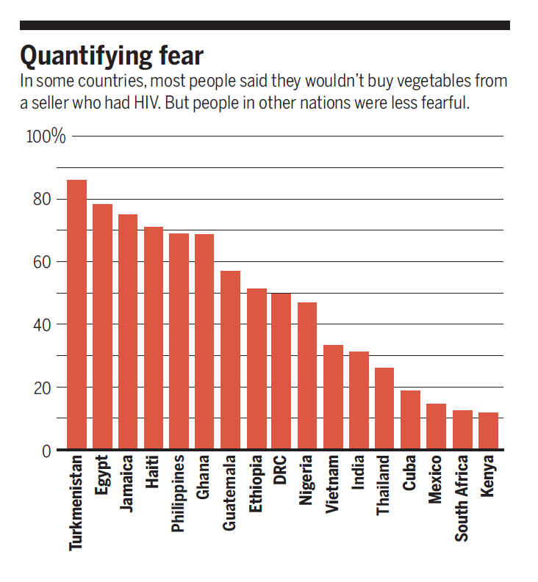
Stigmatization
People with HIV who perceive high levels of social stigma are more likely to delay entering care until very ill
Stigma responsible for 35-50% of infant infections with HIV because it reduced mothers’ adherence to treatment
Notes:
https://science.sciencemag.org/content/369/6510/1419.abstract The social processes of stigmatization can spur the spread of disease. Stigmatization is compounded when the person or population is already marginalized.

Slide 9
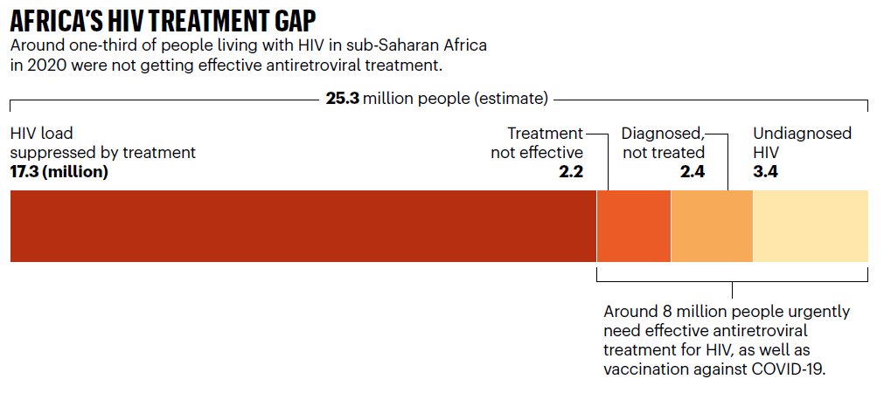
The treatment gap
Notes:
Msomi, Nokukhanya, Richard Lessells, Koleka Mlisana, and Tulio de Oliveira. "Africa: tackle HIV and COVID-19 together." (2021): 33-36.

Slide 10
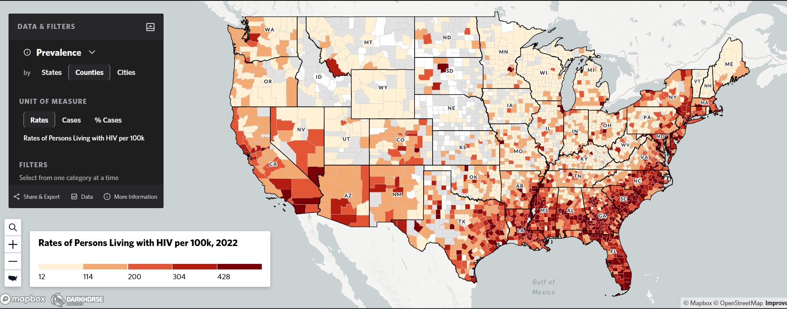
High-risk populations for HIV
Notes:
https://map.aidsvu.org/prev/county/rate/none/none/usa?geoContext=national Rural populations and some smaller cities in the south have high rates of HIV

Slide 11
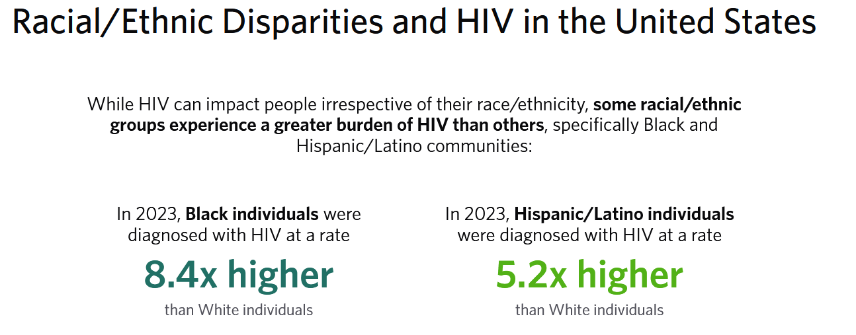

Slide 12
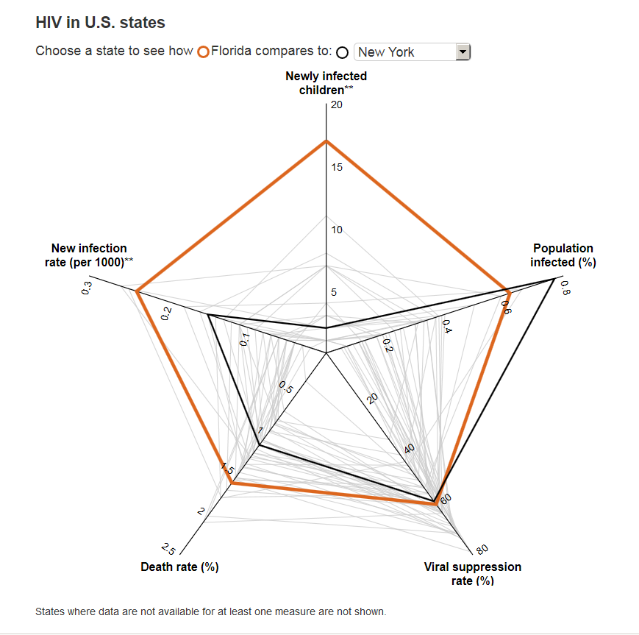
Florida
Large number of Black and Latino residents
Travel gateway to Caribbean, Central and South America
State lawmakers have turned away federal funding for HIV prevention and care, and limited sex education
Florida, California and New York are top three states for HIV cases
Notes:
Compared with other U.S. states, Florida has a big problem. Georgia has the highest rates of new infection, but half the population of Florida. New York has a larger infected population, but has a lower death rate and fewer new infections.
Cohen, Jon. "The Sunshine State's dark cloud." (2018): Science 360(6394) 1176-1179. DOI: 10.1126/science.360.6394.1176

Slide 13
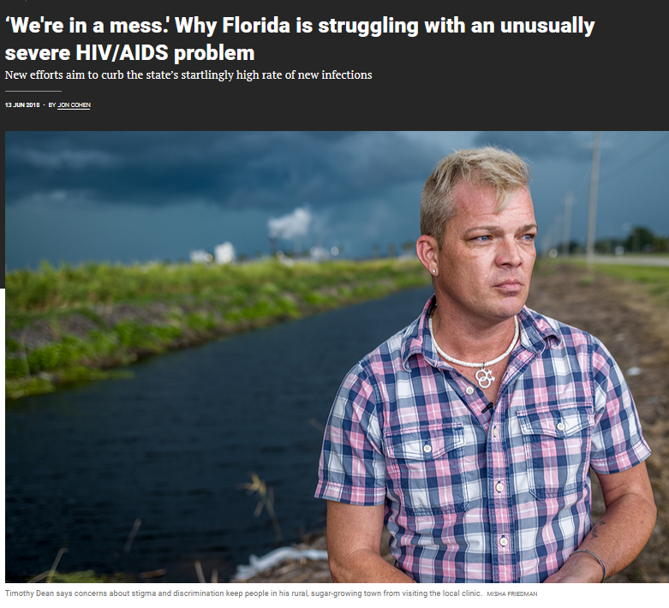
Florida has unusually high AIDS diagnoses because of late testing
A third of HIV positive patients are, ‘lost to follow up’ for reasons of transportation difficulties, stigma concerns, relocation, homelessness, lack of social support, substance abuse, and poverty.
Notes:
Cohen, Jon. "The Sunshine State's dark cloud." (2018): Science 360(6394) 1176-1179. DOI: 10.1126/science.360.6394.1176 https://www.science.org/content/article/we-re-mess-why-florida-struggling-unusually-severe-hivaids-problem

Slide 14
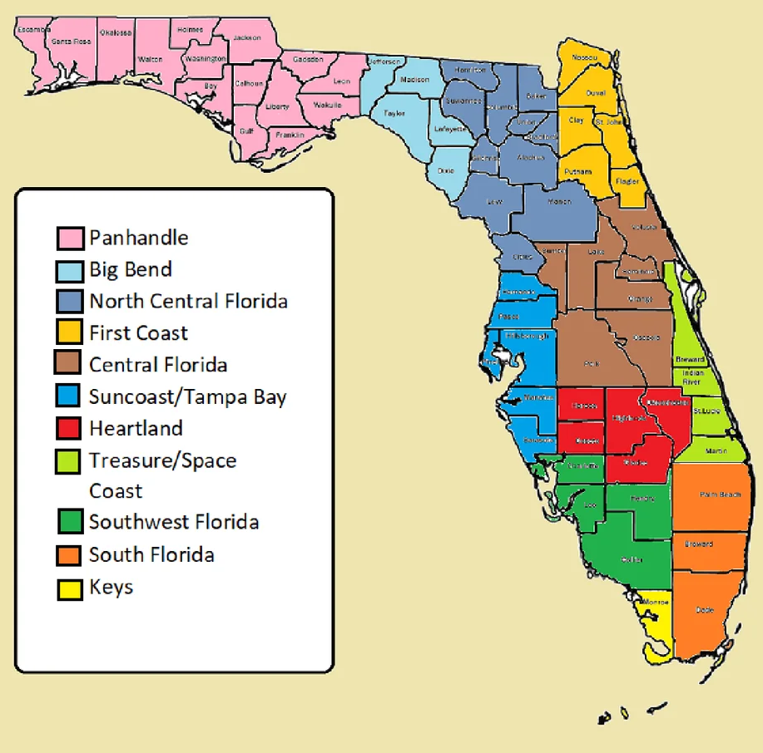
Florida is also socially and politically diverse –like different countries when you compare, for example, rural Panhandle to neighborhoods of Miami
Any campaign to prompt testing and treatment in at-risk populations must be customized to appeal to different cultural backgrounds and levels of disenfranchisement
Notes:
Florida has been slow to approve needle and syringe exchange programs compared to the other 45 states that have them

Slide 15
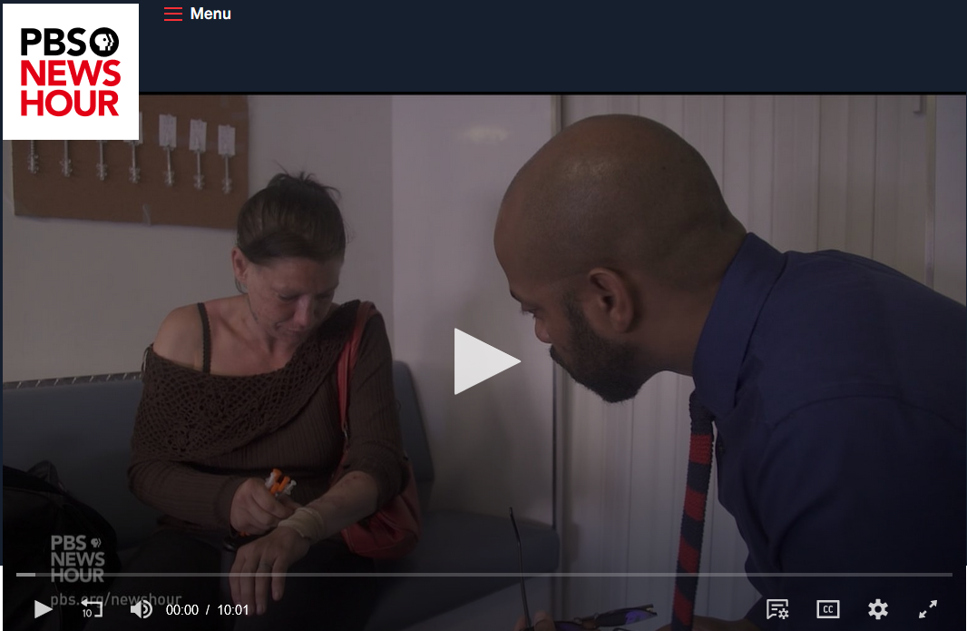

Slide 16
Lenacapavir (2025)
Twice-yearly injectable drug with >99% effectiveness
Developed by the drug company Gilead, who agreed to a generic price drop to $40 per patient per year in 120 low- and middle-income countries in 2027
Negotiated through partnerships involving non-governmental, non-profit organizations and Indian generics manufacturers
“Bridge funding” needed until generics arrive
At reduced price still a hardship for some countries to procure

